Slide 1
Learning to spell in Dutch: A case in point What I learned from going into the classroom
Anna M.T. Bosman
Department of Special Education
Radboud University, Nijmegen, The Netherlands
www.annabosman.eu
10th AWLL International Workshop, Nijmegen, May 12-13, 2016

Slide 2
Learning to spell depends on
Characteristics of the speller
Inter- and intra-language orthographic aspects
Quality of the instruction

Slide 3
Characteristics of the speller
Gender: girls slightly better than boys (Smits et al., 1985; Allred, 1990)
Intelligence: low, significant, correlation between IQ and spelling (van Bon, 1993; Siegel, 2003)
Dialect speakers: slight disadvantage (Hagen, 1985; Treiman et al., 1997)
Visual disability: not hampering (Gompel et al., 2002; Corley & Pring, 1993)
Auditory disability: not hampering (Templin, 1948; Campbell & Burden, 1995)…?
Spelling disability: Nature or Nurture (more later)

Slide 4
Inter and intra language orthographic aspects
Interlanguage: Deep orthographies are harder to learn than shallow (Caravolas, 2004; Wimmer & Landerl, 1997)
Intralanguage:
Consistent words are better spelled than inconsistent (Reitsma & Geelhoed, 2000; Fisher et al. 1985)
HF are better spelled than LF (Assink et al., 1982; Largy et al. 1996)
Orthographic rules are difficult (Assink, 1987; Treiman et al. 1994)

Slide 5
Empirical study 1 (van Leerdam, Bosman, & Van Orden, 1998)
Words (12) | Alternative | in English
paleis | pallijs | palace
rondje | rontju | small circle
bloot | blood | nude
stouterd | stautert | naughty boy/girl
kachel | kaggul | stove
vuilnis | fuilnis | garbage
schilderij | sgilderei | painting
modder | modur | mud
miauwen | miouwen | miaow
nagel | naachel | nail
pantoffel | pantoful | slipper
hengel | henul | fishing rod

Slide 6
Instruction method | Dutch first graders
Reading | 14
Copying | 14
Grapheme selection | 14
Oral spelling | 14
Visual dictation | 14

Slide 7
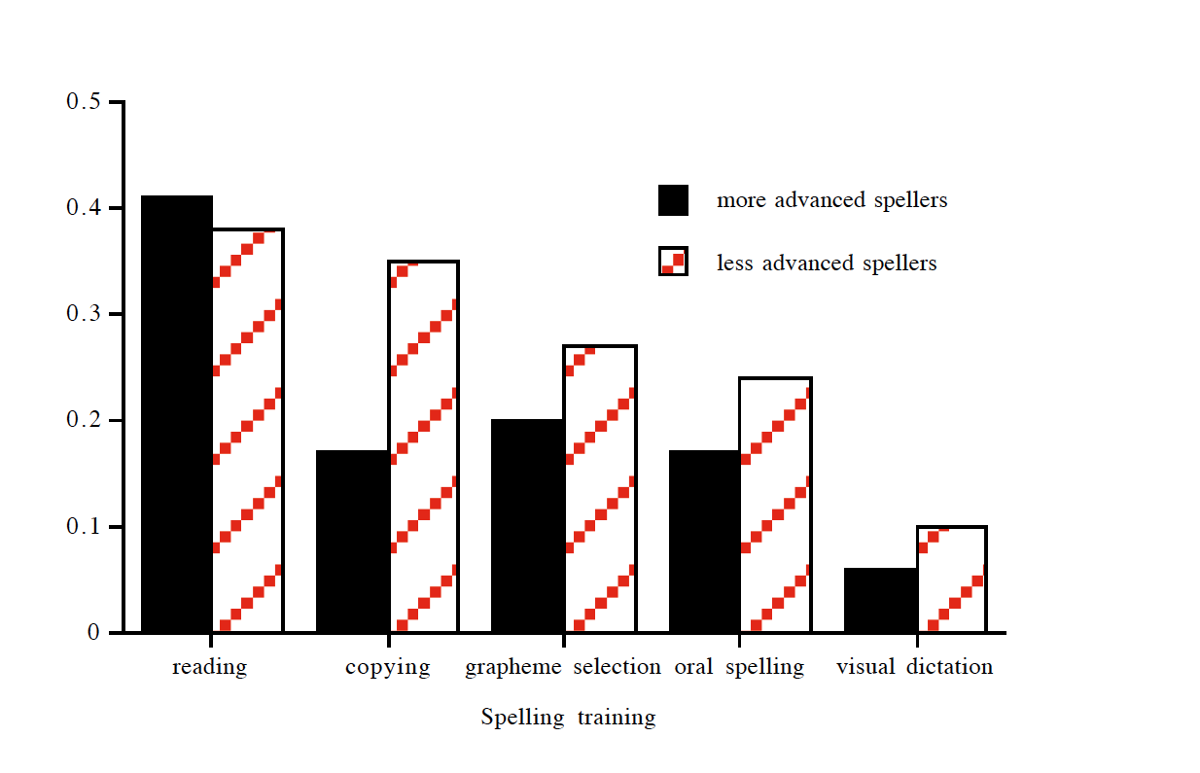
Number of errors

Slide 8
Empirical study 2 (Bosman, van Hell, & Verhoeven, 2006)
Dutch word | in English | Dutch word | in English
asperge | asparagus | giraffe | giraffe
kangoeroe | kangaroo | milieu | environment
bungalow | bungalow | jeans | jeans
kievit | lapwing | passagier | passenger
champignon | mushroom | jungle | jungle
onmiddellijk | immediately | populair | popular
douane | customs | jus | gravy
niveau | level | station | station

Slide 9
School * Instruction | Sju or Jus | n
Regular education (9 years)
Standard | sju | 21
Regularized | jus | 20
Special education (11 years)
Standard | sju | 22
Regularized | jus | 22

Slide 10
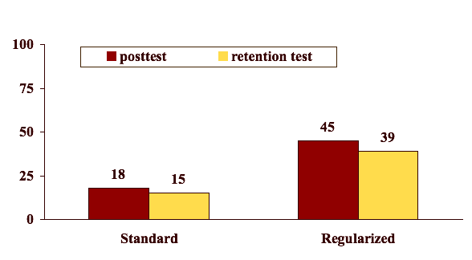
Percentage correct
Regular education

Slide 11
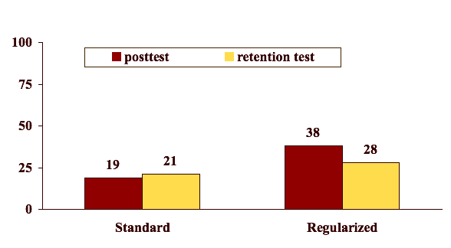
Percentage correct
Special education

Slide 12
Quality of the instruction: Didactical aspects
Practise entire word (van Leerdam et al., 1998)
Practise from heart (van Leerdam et al., 1998; Roberts & Ehri, 1983)
Practise through handwriting (van Leerdam et al., 1998)
Practise until 100% correct (Gerber, 1986)
Immediate feedback (Harward et al., 1994)
Multisensory learning (Calcott et al., 2015)

Slide 13
Quality of the instruction: Teacher requirements
have (Psycho)linguistic knowledge (Bosman, 2007, 2016; Moats & Lyons 1996)
Knowledge of the orthography and the rules underlying the structure of the written language
Knowledge of the problems students encounter when learning to spell
apply Direct instruction (Bosman, 2007, 2016; Clark et al., 2012; Joyce et al., 2014)
Entire classroom
Adaptive teaching by means of ZPD
use Structured instruction (Bosman, 2007, 2016; Simon et al., 2012)
Didactics is based on a task analysis
Error prevention

Slide 14
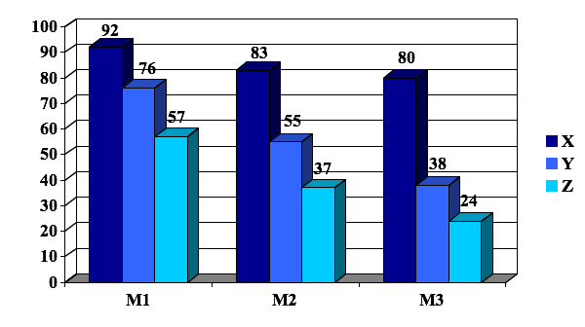
”How to teach children reading and spelling”
March Grade 1

Slide 15
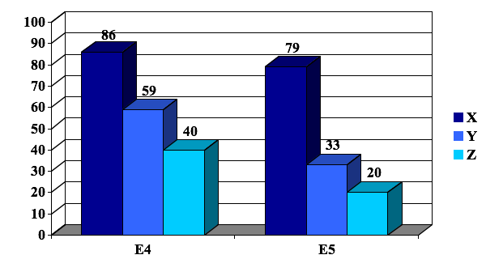
”How to teach children reading and spelling”
June Grade 1

Slide 16
”How to teach children reading and spelling”
Level | 2005-2006 | 2006-2007 | 2007-2008 | 2008-2009
A | 9 | 50 | 45 | 52
B | 32 | 31 | 40 | 26
C | 32 | 19 | 10 | 22
D | 23 | 0 | 5 | 0
E | 4 | 0 | 0 | 0
Average | C | A | A | A
Percentages of Grade-4 students at each level

Slide 17
For English
www.realspelling.fr
or
www.wordworkskingston.com

