Slide 1
Reading and Dyslexia:
A complex system’s approach
Dr. Maarten L. Wijnants
Prof. dr. Anna M.T. Bosman (www.annabosman.eu)
Department of Special Education
Behavioural Science Institute
Radboud University Nijmegen
The Netherlands
Department of Humanities and Social Sciences
IIT, Bombay, October 29 2014

Slide 2
Content
Part 1
Population statistics and Individual development
Component-dominant and Interaction-dominant dynamics
Diagnosing dyslexia
Response distribution and self-similarity
Part 2
Static and dynamic approaches to behavioural analysis
Structured variability
Consequences for dyslexia

Slide 3
Population statistics
&
Individual development

Slide 4
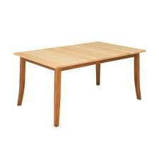
Measurement Theory (Gauss)
X₁ = Τ + ε₁; X₂ = Τ + ε₂; X₃ = Τ + ε₃; X₄ = Τ + ε₄; X₅ = Τ + ε₅ etc.

Slide 5
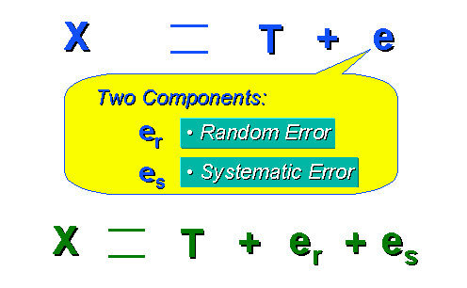
Repeated measures + random error = a reliable estimate of some value

Slide 6
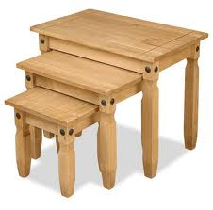


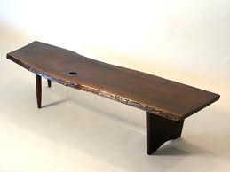


So far, not so good.........
Notes:
How well is population statistics suited to the purpose of the studying the development of one individual. And one more thing..to know development we have to follow it over time.

Slide 7
Ergodic theorems and psychology
Inter-individual variation yield the same results as intra-individual variation when there is
Homogeneity: Each subject needs to obey the same statistical model (nr. of factors is identical, and factor loadings must be invariant)
Stationarity: Statistical parameters should remain invariant over time (Means, SD’s, factor loadings remain the same over time)
From Molenaar (2003, 2004, 2007)

Slide 8
Humans are non-ergodic systems
Development necessarily means non-stationarity
People differ and thus do not obey the same statistical model
THUS: Inter-individual variation does NOT yield the same results as intra-individual variation

Slide 9
Component-dominant dynamics
vs.
Interaction-dominant dynamics

Slide 10
Additive perspective on cognition
A
B
c
= Behaviour
+
+

Slide 11
Interaction dominant perspective
= Behaviour

Slide 12
Diagnosing dyslexia

Slide 13
Definition of Dyslexia (SDN, 2008)
A disability characterised by a persistent problem with the acquisition and/or application of reading and spelling at the word level

Slide 14
Diagnosis
Reading and spelling skills are significantly below that what can be expected from an individual given his or her age and circumstances.

Slide 15
It could have been so nice, if...
Notes:
Ik kan in ieder geval bewijzen dat een duidelijk onderscheid tussen het hebben van dyslexie of het niet hebben ervan niet bestaat.
Stel we hebben een leestest afgenomen bij duizenden leerlingen tussen 7 en 8 jaar.
De gemiddelde score is rond de 60 woorden per minuut. Er zijn kinderen die nog veel meer woorden in een minuut kunnen lezen en kinderen die er een stuk minder lezen.
Wanneer is dan de score zodanig dat je spreekt van leesproblemen?
Dat zou heel makkelijk zijn als er kinderen zijn die helemaal buiten het normale gebied liggen, zoals links op deze grafiek. Dan weet je gewoon dat iemand met een score tussen 0 en 15 dyslectisch is.
Helaas ziet de werkelijkheid er niet zo eenvoudig uit.
Want de volgende dia toont ons de keiharde realiteit.

Slide 16
however, this is reality
Notes:
Helaas ziet de werkelijkheid er niet zo eenvoudig uit.
Want deze dia toont ons de keiharde realiteit.

Slide 17
Dyslexia is associated with
Phonological awareness and memory problems
Orthographic awareness and memory problems
Visual-perceptual deficit
Magnocellular deficit
Auditory-processing problems
Rapid-naming colours, numbers, etc…problems
Attention-deficit problems
Motor problems
Language-related problems
Neurobiological factors
Environmental problems
etc……..

Slide 18
Response distribution
&
self-similarity

Slide 19
Types of distributions*
Gaussian Log-normal Power law
* see also Holden & Rajaraman, 2012

Slide 20
Participants
 | Dyslexic | Non dyslexic
Girls / Boys | 7 / 13 | 8 / 15
Word-reading score* | ≤ 6 | ≥ 12
Pseudoword-reading score* | ≤ 6 | ≥ 12
Age in years | between 11 and 13
* Standard score: M = 10, SD = 3; Below 6 serious reading problem

Slide 21
Continue Leestaak
+++
table
paint
hotel
560 words were read in one session
RT’s and errors were measures
Holden, J.G., Greijn, L.T., van Rooij, M.J.W., Wijnants, M.L., & Bosman, A.M.T. (online,
August 2014). Dyslexic and skilled reading dynamics are self-similar. Annals of Dyslexia.

Slide 22
Distributions

Slide 23
α-parameter divides groups

Slide 24
Rapid-naming of colours
…… n = 560

Slide 25
Arithmetic-decision task
3 + 4 = 7 (yes) 1 + 1 = 3 (no)
3 – 1 = 1 (no) 9 – 1 = 6 (no)
4 + 2 = 5 (no) 7 + 2 = 8 (no)
3 + 5 = 8 (yes) etc..
7 – 1 = 6 (yes) …….
7 + 1 = 6 (no) ..…..
6 + 3 = 9 (yes) n = 560

Slide 26
Erikson-flanker task
trial a => => => => => (max congruent)
trial b => => <= => => (max discongruent)
trial c <= <= <= => =>
trial d <= => => <= =>
.….. n = 560

Slide 27
Number of Log-normal distributions
Dyslexic |  |  |  | Non- dyslexic
3 | 2 | 1 |  | 4 | 1 | 2
2 | 2 | 0 |  | 3 | 3 | 2
0 | 0 | 1 |  | 2 | 3 | 2
2 | 1 | 0 |  | 4 | 2 | 4
1 | 1 |  |  | 2 | 3 | 2
2 | 0 |  |  | 4 | 3 | 3
0 | 1 |  |  | 4 | 3
1 | 1 |  |  | 4 | 2
21 log-normal distributions |  |  |  | 62 log-normal distributions

Slide 28
Conclusion
Dyslexic readers have more power-law behaviour in non-reading tasks than non-dyslexic readers
Behaviour is the result of
an interactive complex system,
that is why:
Misfortunes hardly come singly

Slide 29
Static and dynamic
approaches to
behavioural analysis

Slide 30
Static analysis
Cognitive processes are measured by averaging responses collected over time
Similar stimuli yield the same processing steps, thus activation of the same components
Leads to the same True score + E
Response times are stationary and ergodic
Response times are independent

Slide 31

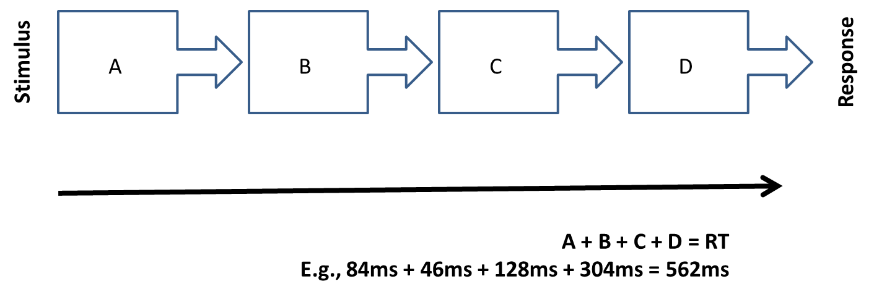
Component-dominant dynamics
Additive component interactions

Slide 32
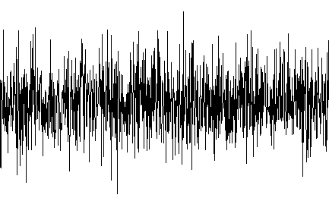
Component-dominant dynamics
X = T + E

Slide 33
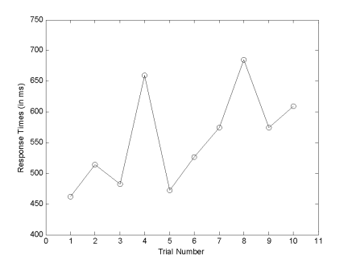
Static analysis
Word-item properties → RT
  e.g., Word length: long words → slower responses
Fictitious example
Short | Long
768 ms | 802 ms
Notes:
AS TREATMENT CELLS IN A VARIANCE COMPONENT-DESIGN

Slide 34
Static analysis
Sequential order is not important
  Trial-by-trial variability is random noise
Shuffling the data does not change:
    Mean
    SD
    Treatment effect

Slide 35
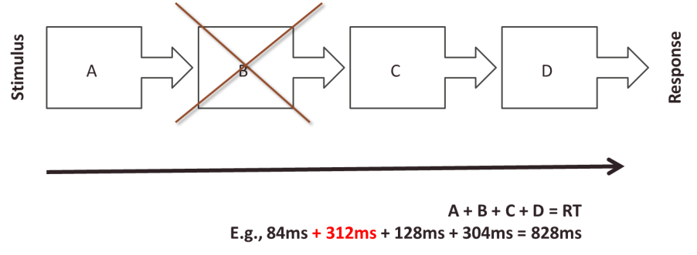
Learning disabilities
Contemporary theories view learning disabilities as single causes
Reduce the problem to deficient components (biological, neurological, cognitive, etc.)
List of criteria is endless

Slide 36
Dynamic analysis
Cognitive processes are measured by parameters of change over time
Similar stimuli yield processes that interact across multiple time scales
Thus, activation patterns are never identical
Non-stationarity and non-ergodicity imply that true scores are not informative
Temporal order is crucial

Slide 37
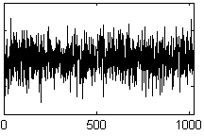
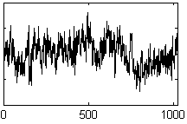
Dynamic analysis
Collect RT’s of many trial over time
Observe temporal structure of variability
(How) does the reading process change over time?
Random variability
Structured variability

Slide 38
Dynamic analysis
Sequential order IS important
Trial-by-trial variability is NOT random noise
There is meaningful temporal STRUCTURE
    providing useful information about the organization of the cognitive system
Shuffling DOES matter → Temporal structure is lost

Slide 39
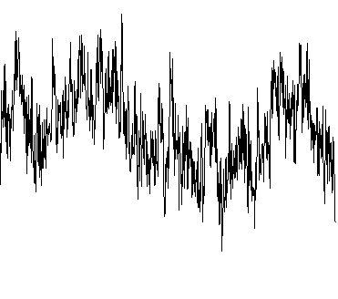
Interaction-dominant dynamics
X = structure
Notes:
T zit in structuur, long-range dependence
Koppeling van tijdschalen, snelle en trage processen. Over de S-R grenzen heen.
Visual: Sines (traag snel, animate, gaat over in echte TS

Slide 40

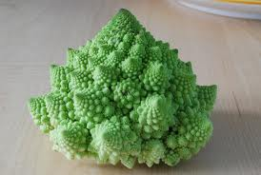

Dynamic analysis
Methods to quantify structure
1/f noise (fractal scaling)
  Spectral analysis
  Standardized Dispersion Analysis
  Detrended Fluctuation Analysis
Recurrence Quantification Analysis (RQA)

Slide 41
Structured variability

Slide 42
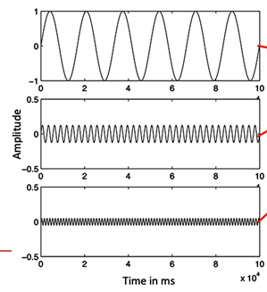
Structured variability
BIG AND SLOW
BIG
SMALL
SMALL AND FAST
SLOW
FAST
Notes:
Changes occur at all time scales simultaneously
Size of change is proportional to frequency (hence, 1/f noise)

Slide 43
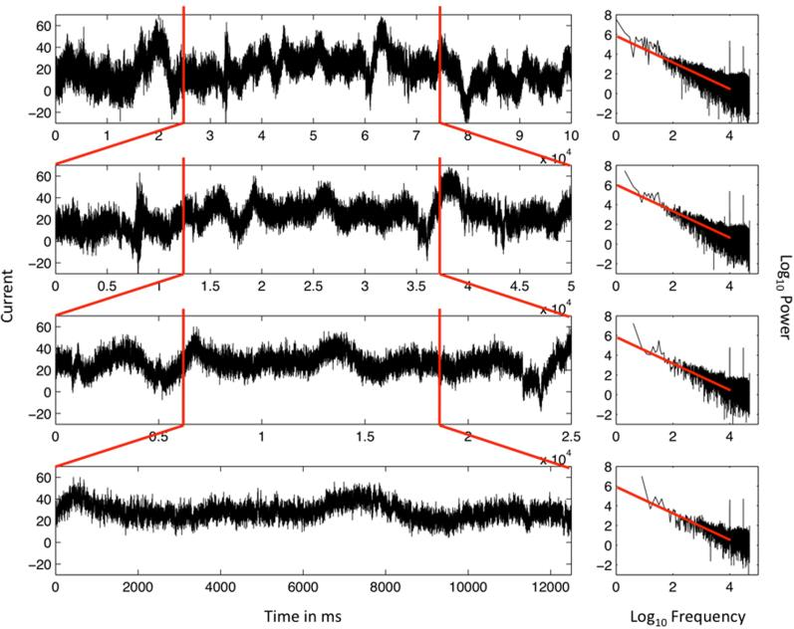

Slide 44
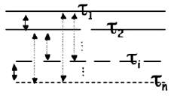
A hallmark of complexity
Changes on multiple time scales are coupled to changes on other timescales → interaction dominant dynamics

Slide 45
Disorganized
Well-coordinated behavior
Rigid & persistent
Notes:
DISORDER -- Flexibly ORGANIZED -- ORDER -- SLOW CHANGES ARE EVEN BIGGER, FAST CHANGES FROM TRIAL TO TRIAL ARE VERY SMALL, unable to adapt.

Slide 46
Heartbeat intervals
  Deviations from 1/f noise correlate with mortality risk (Goldberger, 1997; Mäkikallio et al., 2001; ; Peng et al., 1995)
Smaller deviations from 1/f noise
  Aging (Goldberger, 2002)
  Obese children (Vanderlei, Pastre, Júnior, & de Godoy, 2010)
Wijnants, M.L. (2014). A review of theoretical perspectives in cognitive science on the
presence of scaling in coordinated physiological and cognitive processes.
Journal of Nonlinear Dynamics, Vol. 2014, Article ID 962043.
Notes:
Congestive heart failure
Ventricular arrhythmia (Goldberger, 1997; Peng et al., 1995)

Slide 47
Human gait
FRACTAL PERFORMACE
RANDOM
PERFORMANCE
Old adults Parkinson disease
Old adults
Young adults

Slide 48
Consequences for
reading fluency

Slide 49
Learning disabilities: prediction
Notes:
Control hierarchy theory plays a fundamental role in nonlinear analysis, like that of structural hierarchy theory in linear analysis
Core assumptions require empirical support, a basis in reality

Slide 50
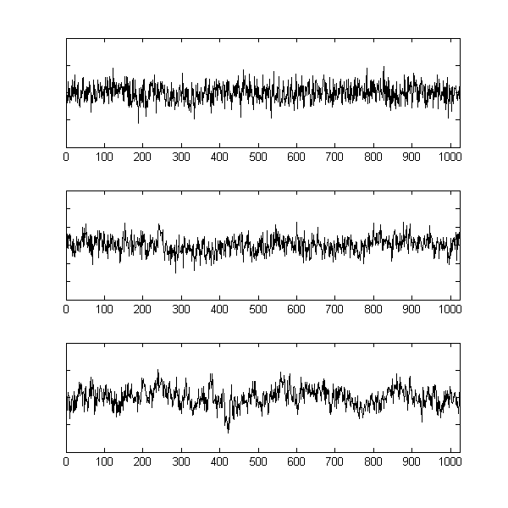
Learning disabilities: prediction
DYSLEXIA
READING
DIFFICULTIES
AVERAGE READING

Slide 51
Word-Naming task
strong
sword
friend
+++
560 single-syllable words
Fast + accurate
n = 15 (dyslexic children)
n = 15 (controls)
6 to 8 years old
Wijnants, M. L., Hasselman, F., Cox, R. F. A., Bosman, A. M. T., & Van Orden, G. (2012). An
interaction-dominant perspective on reading fluency and dyslexia. Annals of Dyslexia,
62, 100-119.

Slide 52
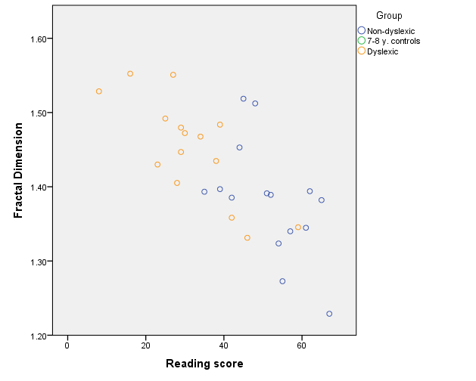
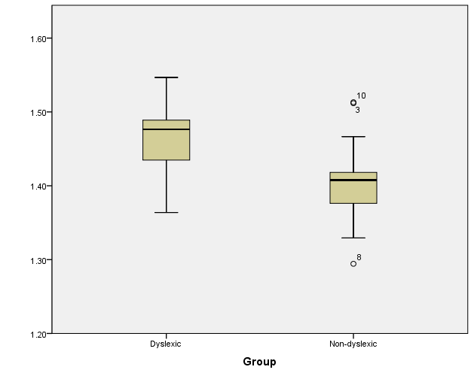
Does Dyslexia exist?
RANDOM
PERFORMANCE
FRACTAL PERFORMACE
NOT SO GOOD READERS
GOOD READERS

Slide 53
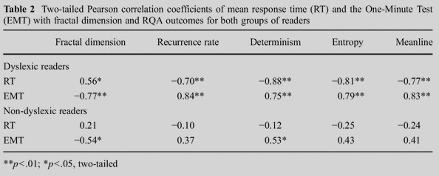
Dynamic analysis
→ Dynamics are strongly correlated with the severity of the reading impairment

Slide 54
Conclusions: Static analyses
Static analyses are designed to expose single components and simple cause-effect relations
Can not inform about interdependent relations
This is why traditional research focuses only on isolated cognitive functions

Slide 56
Conclusions: Dynamic analyses
Dynamic analyses inform about the interdependence of system components
What static analyses discard as ‘noise’ is strongly correlated to the severity of reading difficulties
Dynamic analyses inform about the coordination over timescales well outside the stimulus-response interval

Slide 57
Conclusions: Dyslexia
Is dyslexia a specific, unicausal disorder?
No, dyslexia is a symptom of a more diffuse and complicated problem
Dyslexia is a problem of coordination
  A coordination problem can have multiple, not single causes
  A coordination problem can have multiple effects (Comorbidity?)

Slide 58
Many thanks to
our friend and mentor the
late Dr. Guy Van Orden

Slide 60
RQA
Reconstruct the phase space of the system:
  Make a delayed copy of the time series
  Plot it against the original time series
    Pick a delay that give you the most unique information
  The number of delayed copies is the number of dimensions
    Pick number of dimensions that gives the least false neighbours

Slide 61
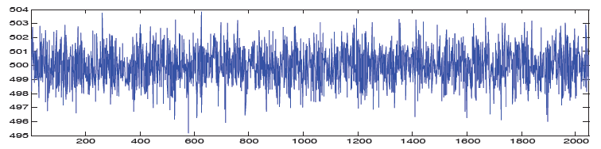
RQA
Z
Y
X
X
Y
Z
Notes:
General recurrence: RR=denseness/confinement/compactness of attractor
Various attractors: DET=regularity/determinism/patternedness; MeanL=stability; MaxL=stability ; ENT=complexity
Point attractors: LAM=regularity; TT=rigidity(~1/flexibility) ; MaxVL=rigidity/~flexibility
DET → Regularity of pattern (predictability / deterministic) → Higher = more regular (as in attention demanding cognitive tasks)
MaxL → (Math) Stability of pattern → Lower = less stable (as in attention demanding cognitive tasks)
ENT → Deterministic structure of pattern (indicator of self-organization) → Lower = less complex (as in attention demanding cognitive tasks)

Slide 62
RQA outcomes
Recurrence = points that are nearby
  Confinement of the attractor (behavior in phase space)
Determinism = points that remain nearby
  Recurrences sustained over time
Entropy = entropy of distribution of recurring patterns
  Complexity of the attractor
Mean line/ max line = how long points remain nearby
  i.e., how stable is the system
Notes:
Complex dynamical patters → higher RQA values

