Slide 1
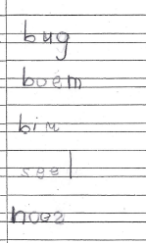
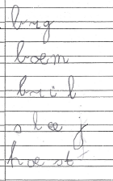
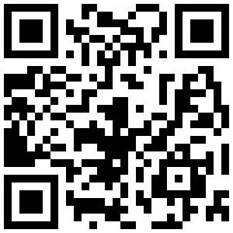
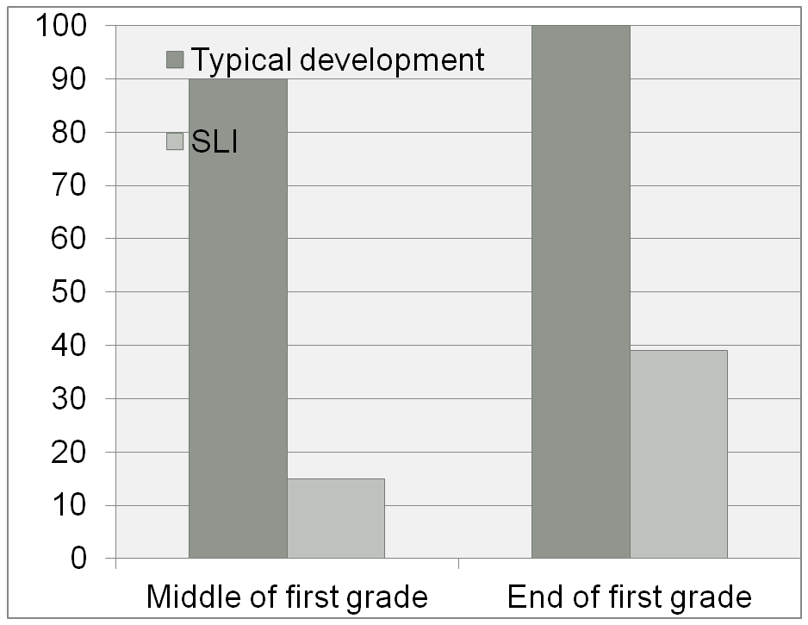
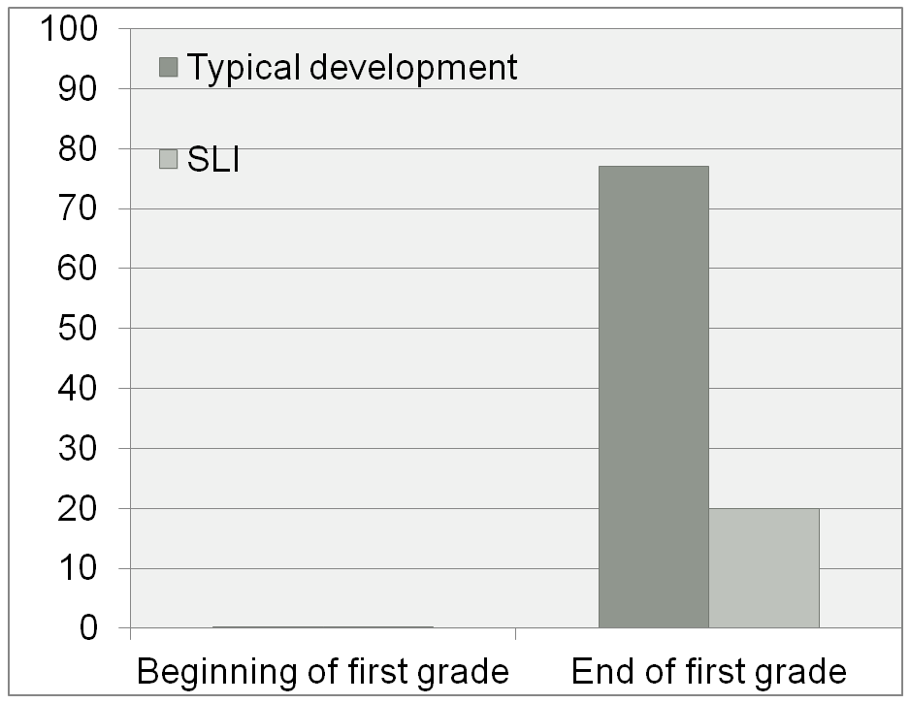
Specific Language Impairment Affects the Early Spelling Process Quantitatively but not Qualitatively
Kim A. H. Cordewener, Anna M. T. Bosman, Ludo Verhoeven
Behavioural Science Institute, Radboud University, Nijmegen, the Netherlands
Different?
Typical development
SLI
Method
Participants
Typical development SLI
39 first grade children 59 first grade children
22 girls, 17 boys 21 girls, 38 boys
79.7 months 82.2 months
Conclusion
The results indicated that children with SLI do have a quantitative delay in both grapheme knowledge and spelling during first grade. However, there was no qualitative difference between the early spelling of children with SLI and typically developing children. This indicated that children with SLI have the same spelling process as typically developing children, although they develop slower.
Quantitative results
Introduction
Educational implications
Children with specific language impairment (SLI) are at risk for developing spelling problems. To be able to provide adequate help, it is necessary to establish whether children with SLI spell differently than typically developing children. If the spelling process of children with SLI is different, spelling education has to be adapted to their specific needs. If the spelling process of children with SLI is the same but only delayed, these children need more spelling instruction, but not necessarily different spelling instruction.
The present study compared the grapheme knowledge and spelling process of children with SLI to that of typically developing children both quantitatively (amount of spelling errors) and qualitatively (types of spelling errors).
Teachers of children with SLI can practice the same skills as with typically developing children.
Teachers of children with SLI have to intensify spelling instruction and practice.
Spelling performance is strongly influenced by the quality of spelling education, so good teachers can make all the difference.
Percentage of children that reached the criteria for grapheme knowledge
(criterion = all 34 graphemes correct)
Percentage of children that reached the criteria for spelling
(criterion = 20 words correct or more)
Qualitative results
 | Typical development | SLI
Type of grapheme | =
Grapheme position | =
Word length | short words vs. long words smaller difference | short words vs. long words
Word structure | CVC vs. CVCC | CVC vs. CVCC CVC vs. CCVC
Word frequency | =
For more information
Cordewener, K. A. H., Bosman, A. M. T., & Verhoeven, L. (2012). Specific language impairment affects the early spelling process quantitatively but not qualitatively. Research in Developmental Disabilities, 33, 1041-1047.
Cordewener, K. A. H., Bosman, A. M. T., & Verhoeven, L. (2012). Characteristics early spelling of children with Specific language impairment. Journal of Communication Disorders, 45, 212-222.
E-mail: K.Cordewener@pwo.ru.nl
Behavioural Science Institute

